Slide 1
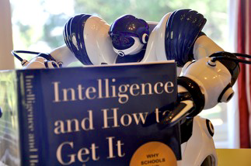
Introduction
Pattern Recognition is the study of how machine can :
observe the environment .
learn to distinguish the object of interest.
make sound and reasonable decisions about the category of the pattern
Slide Credit: Luis Gustavo Martins

Slide 2

Human Perception
Humans have developed highly sophisticated skills for sensing their environment and taking actions according to what they observe, e.g.,
Recognizing a face.
Understanding the spoken words.
Reading handwriting
Distinguishing fresh food from its smell.
………………………………………
We would like to give similar capabilities to machines.

Slide 3
Human & Machine Perception
We are often influenced by the knowledge of how patterns are modeled and recognized in nature when we develop pattern recognition algorithms.
Research on machine perception also helps us gain deeper understanding and appreciation for pattern recognition systems in nature.
Yet, we also apply many techniques that are purely numerical and do not have any correspondence in natural systems.

Slide 4
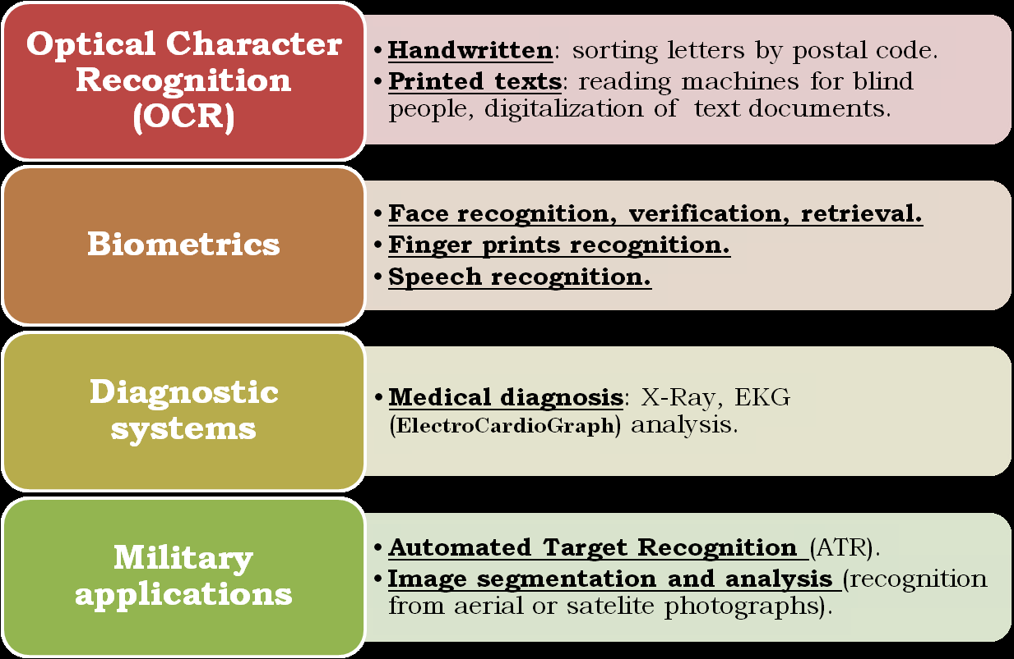
Example of Applications

Slide 5
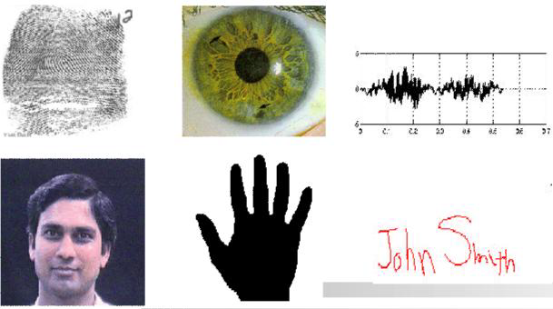
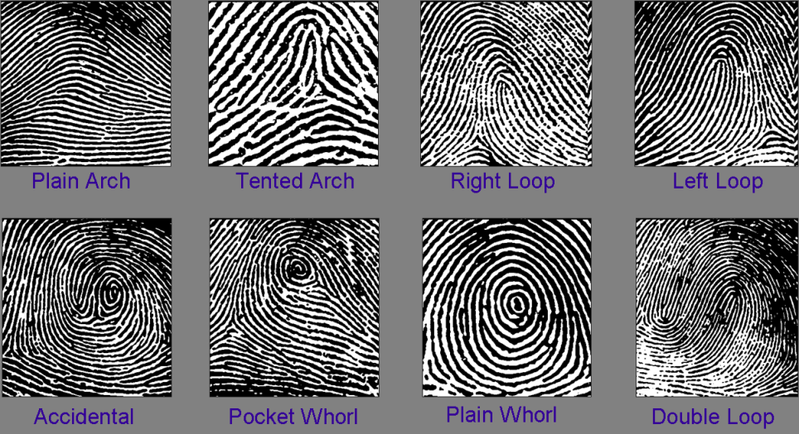
What is a Pattern?
A Pattern is an abstract object, or a set of measurements describing a physical object.
Many types exist:
Visual, temporal, sonic, logical.......

Slide 6
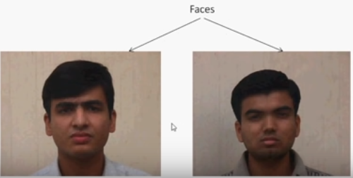
What is a Pattern Class (Category)?
A pattern class is:
a set of patterns sharing common attirbutes.
a collection of “similar”, not necessarily identical, objects.
During recognition given objects are assigned
to prescribed classes.

Slide 7
What is Pattern Recognition?
Pattern Recognition(Classification) is:
The process of assigning given objects to prescribed classes.
Theory, algorithms, systems to put Patterns into Categories.
Relate perceived Pattern to previously perceived Patterns.
Learn to distinguish patterns of interest from their background

Slide 8
Pattern Recognition
Two phase process:
Training /Learning
Learning is hard and time consuming
System must be exposed to several examples of each class.
Creates a “model” for each class.
Once learned, it becomes natural.
Detecting /Classifying

Slide 9
What is Classifier?
A classifier is a machine which performs the classification.

Slide 10
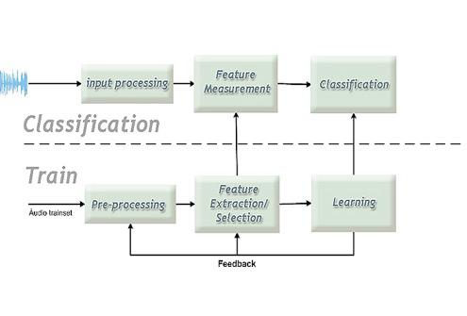
Classificassion or Detection

Slide 11
How can a Machine learn from data?
Supervised Learning: a teacher provides a category label or cost for each pattern in the training set.
Classification
Unsupervised Learning: the system forms clusters or natural groupings of the input patterns (based on some similarity criteria).
Clustering
Reinforcement learning: no desired category is given but the teacher provides feedback to the system such as the decision is right or wrong.

Slide 12
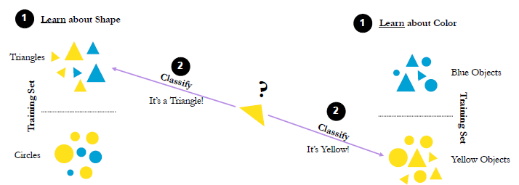
Supervised Learning
a “teacher” provides labeled training sets, used to train a classifier.

Slide 13
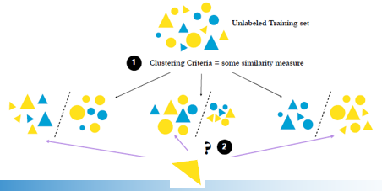
Unsupervised Learning
No labeled training set is provided.
system applies specific clustering/grouping criteria to unlabeled dataset.
Clusters/groups together to most similar objects (according to given criteria)
K-Means, Density-Based Spatial (DBSCAN), Mean Shift, Agglomerative, K-Means ensemble agglomerative

Slide 14

Reinforcement learning applications
Enables a robot to autonomously discover an optimal behavior through trial-and-error interactions with its environment.
Health care, clinical observations and patient assessments provide the input data, with the algorithm outputting treatment options to provide the patient's most desirable environmental state. RL is used to automate decision-making within these ongoing treatment regimes.
Bussiness, One example of reinforcement learning e-commerce is product recommendation systems. These systems use RL algorithms to learn from customer behavior, such as search queries, clickstream data, and purchase history.
n NLP, RL can be used in text summarization, question answering, and machine translation
Self-driving cars, some of the autonomous driving tasks where reinforcement learning could be applied include trajectory optimization, motion planning, dynamic pathing, controller optimization, and scenario-based learning policies for highways.

Slide 15
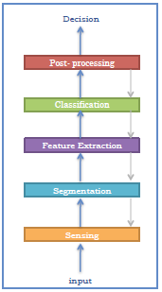
Pattern Recognition Proces
Data acquisition and sensing:
Measurements of physical variables.
Important issues: bandwidth, resolution , etc.
Pre-processing:
Removal of noise in data.
Isolation of patterns of interest from the background.
Feature extraction:
Finding a new representation in terms of features.
Classification
Using features and learned models to assign a
Pattern to a category.
Post-processing
Evaluation of confidence in decisions.

Slide 16
How to select an appropriate algorithm efficiently in ML?
How much data you have and is it cotinuous?
Is it a classification or regression problem?
Whether the data is labeled or unlabeled?
Visualize the data to understant the pattern in the given data set.
https://www.youtube.com/watch?v=38SUUaMX5Rg
https://www.youtube.com/watch?v=dzH69iV-4MM&t=102s

Slide 17
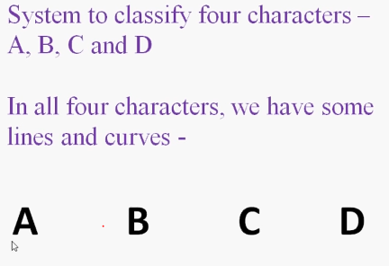
Example

Slide 18
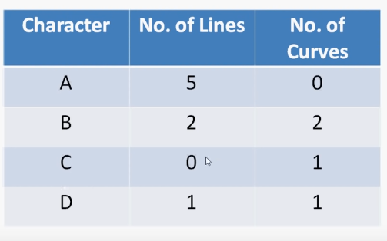
Example

Slide 19
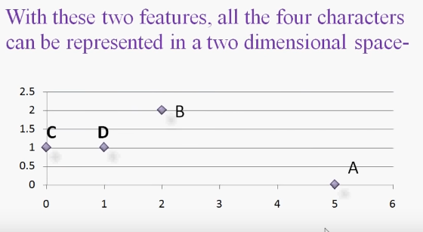
Example

Slide 20
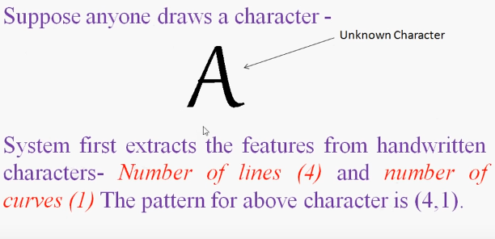
Example

Slide 21

More Features

Slide 22
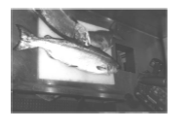
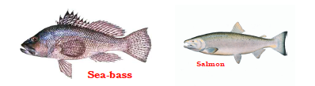
A Case Study: Fish Classification
Problem Definition:
Sorting incoming fish on a conveyor belt
according to species.
Assume that we have only kinds of Fish
Sea Bass
Salmon

Slide 23
A Case Study: Fish Classification
Chanllenges:
Lighting Conditions.
Position of the fish in the conveyor betl.
Camera noise.
etc..
Exisiting Works or State-of-the-art.
Propose Solutions: Possible steps could be:
Campturing image.
Isolate Fish
Take measurements.
make decision

Slide 24
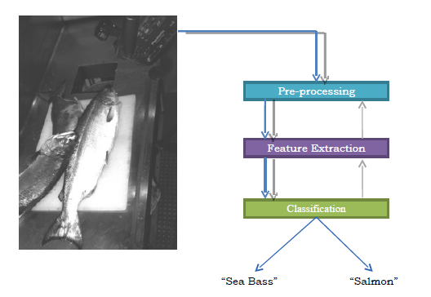
A Case Study: Fish Classification

Slide 25
A Case Study: Fish Classification
Pre-processing:
Image enhancement.
Separating touching or occluding fish.
Finding the boundary of the fish.
Features:
Length
Lightness
Width
Number and shape of fins
Position of the mouth
Etc …

Slide 26
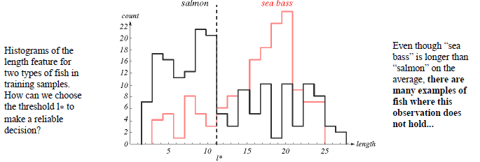
A Case Study: Fish Classification
Selecting Features:
Assume a fisherman told us that a sea bass is generally longer than a salmon.
We can use length as a feature and decide between sea bass and salmon according to a threshold on length.
How can we choose this threshold?

Slide 27
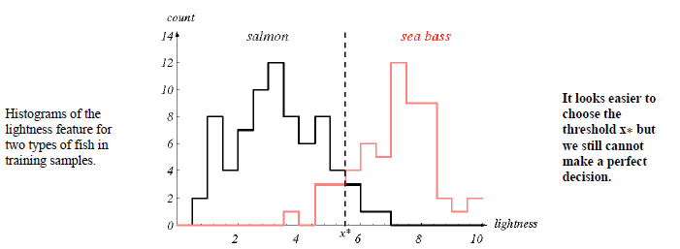
A Case Study: Fish Classification
Selecting Features:
Average lightness of the fish scale.

Slide 28
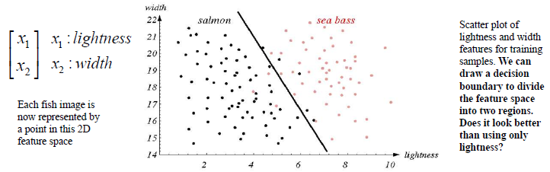
A Case Study: Fish Classification
Multiple Features:
Single feature might not yield the best performance.
To improve accuracy, we might have to use more than one feature at a time.
Combinations of features might yield better performance.

Slide 29
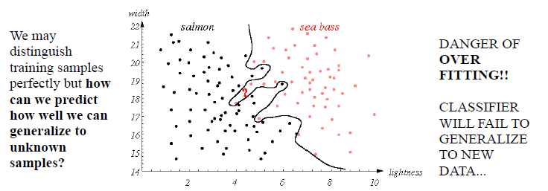
A Case Study: Fish Classification
Designing a Classifier:
Can we do better with another decision rule?
More complex models result in more complex boundary.

Slide 30
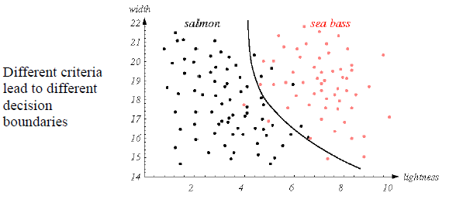
A Case Study: Fish Classification
Designing a Classifier:
a tradeoff between decision rules and their performance for unknown sample.

Slide 31
Conclusions
Pattern Analysis enables the Machine to learn about the given data.
Proper Features extractions leads to better performance.
Desiging better decision boundary is necessary for better performance.
Combination of better features and improve boundary.

